Slide 1
The Three Types Of Unit Tests
Alex Howson

Slide 2
Introduction
The types…

Slide 3
Examples
https://github.com/Steelstone3/Community-Of-Practice/blob/main/supporting_documents/types_of_testing.md

Slide 4
Response Testing (Return Value)
When invoking behaviour in code from a test the direct response can be tested against an expected known value.

Slide 5
Response Testing (Exception)
This also comes under the category of response testing as the response of the code under certain conditions will be to throw an exception.

Slide 6
Side Effect Testing
When invoking behaviour in code from a test the side effects of that code can be tested against an expected known values.

Slide 7
Interaction Testing (Test Doubles)
When invoking behaviour in code from a test the method calls of dependencies can be tested to demonstrate:
- The number of calls a dependency’s method made (Once, Many or Exactly)
- The method calls a dependency didn’t make

Slide 8
Test Doubles
Wrapping classes since ~2006

Slide 9
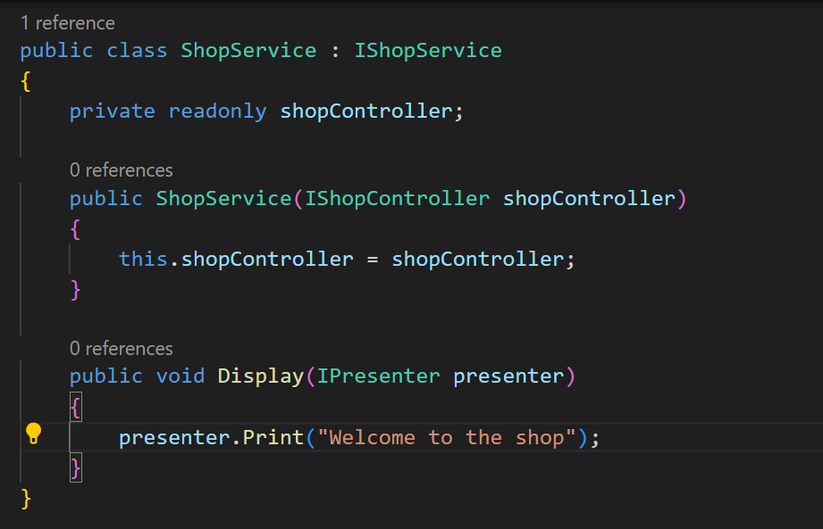
Test Doubles
Commonly called “Mocks” is a series of abstract wrappers for dependencies.
Interface dependencies of a class/ method get overridden with a “Mock” implementation
For test doubles to work they require the same reference to provide the wrapped “fake” implementation

Slide 10
Mocks/ Spys
- Mocks and Spys are both concerned with the execution of code
- Mocks are concerned that code has been called
- Spys are concerned that code has been called, how many times and if any other calls have been made

Slide 11
Stubs
- Stubs are test doubles that return a constant value
- Stubs should return mocked objects or a constant primitive value
- Stubs are used for testing pathing within the application

Slide 12
Dummy
- Dummies are test doubles used to fill out parameter lists and have no active role in given tests

Slide 13
Test Structure
Given… When… Then

Slide 14
Given… When… Then Test Structure
Otherwise known as arrange, act and assert (triple A) testing.
When writing tests, it is important to structure them correctly so as not to fall victim to testing code smells.
GIVEN (Arrange)
Given provides the test with known values. Depending on known values is important for testing as it reduces test “flakiness”.
WHEN (Act)
When is the method the code being tested should invoke. There should only be one method being called in this step.
THEN (Assert)
Then is the assertions being made about the code’s expected behaviours.

Slide 15
Testing Smells
Some things to watch out for…

Slide 16
Dependent On Method Calls
Depending on methods reduces to eliminates test isolation. This means that changes to a method effect the test setup and therefore outcome.
Importantly tests should depend on known values defined within the test class.
Example…

Slide 17
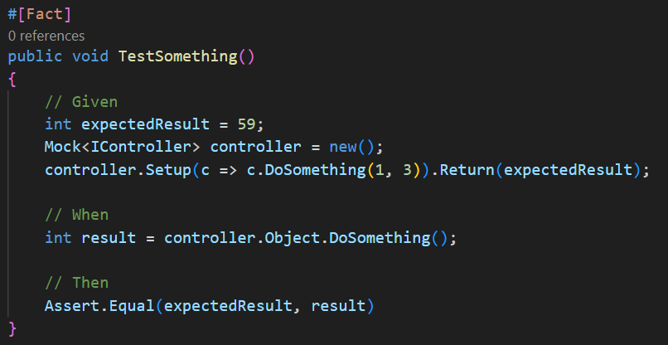
Asserting Stubs
Asserting stubs is a common mistake to those new to or lacking in understanding of test doubles. Stubs are test doubles that return a “fake” predefined value regardless of how the method is set up.
For Example…
This test tests the stub returns what the stub returns…

Slide 18
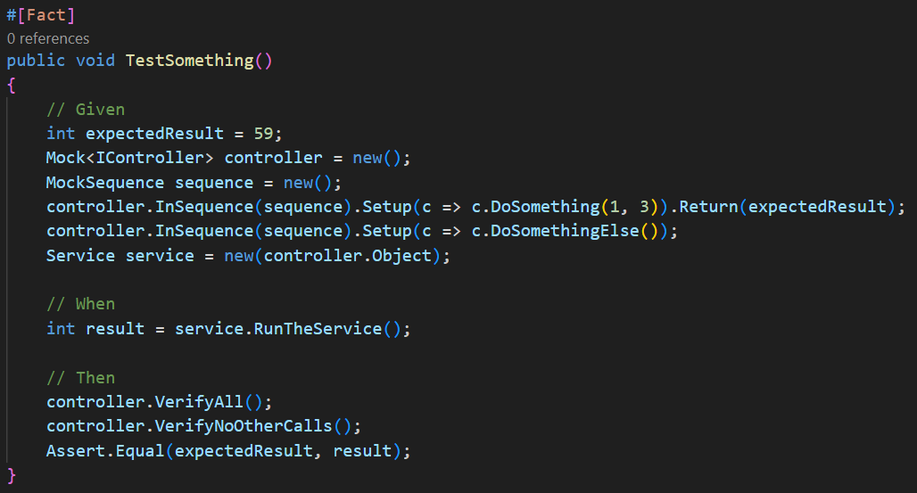
Asserting Stubs – Solution
Use interaction testing. In this case the “service” depends on “controller”. The “DoSomething(int, int)” method can be stubbed to check things like the sequence in which the method was called, the number of times or whether anything else was called.
For Example…

Slide 19
Multiple Method Calls

Slide 20
Thank you
Alex Howson

